Slide 1

HISTORY OF THE EMERGENCE OF INDEPENDENT BANGLADESH
Dr. Md. Abdul Alim
B. A (Hon’s), M. A (History), M. Phil (Raj), Ph. D (Raj)
Email:doctorabdulalim64@gmail.com
Cell: +880 1718-787466

Slide 2
DISCUSSION CONTENTS
What is Race?
Negrito, Austro-Asiatic people, Mongoloidt, Dravidian, Aryans, Others
Origin of Bangali Nation
Bengal during the Age of Mauryan Empire (324 BC to 186 AD)
Bengal during the Age of Gupta Period approximately 319 to 467AD
The independent Kingdom of Banga
The rise of Gowda under the leadership of Shashank
Matsyanyayams

Slide 3

WHAT IS RACE?
A category of people who have been singled out as inferior or superior, often on the basis of real or alleged physical characteristics.

Slide 4

WHAT IS RACE?
Some people views race as:
Skin color: The Caucasian race
Religion: The Jewish race
Nationality: The British race
Entire human species: The human race

Slide 5
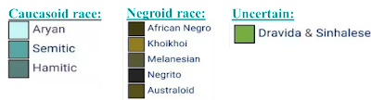
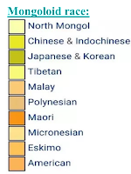
RACIAL CLASSIFICATION
Caucasoid (White) stock from Southwest Asia & Europe sources.
Negroid (Black) stock from African sources.
Mongoloid (Oriental/ Amerindian) stock which arose in East Asia.
Australoid (Australian Aborigine and Papuan) stock of Southeast Asia origins.

Slide 6
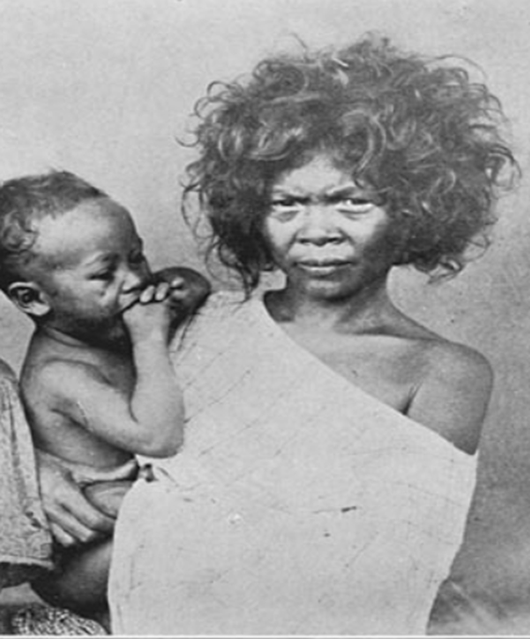
NEGRITO
The book “Early Indians: The story of our ancestors and where we came from” written by Tony Joseph considers that the modern humans (Homo sapiens) first made their way from Africa into the Indian subcontinent some 65,000 years ago.
It is thus perceived that African origin Negrito tribe came here as original settlers.
Few people of Negrito tribe are still considered existing in the places like down Sunderban, Andaman, Nicobar, etc.

Slide 7
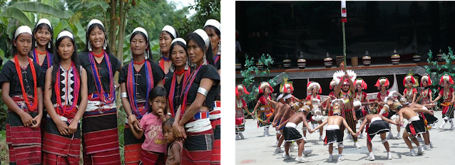
AUSTRO-ASIATIC PEOPLE
In the dispersal process the groups of the people who went to South-East Asia are known as Austro-Asiatic people.
They developed languages which are known Austric Language.
They came Bengal Basin in 10000-12000 years ago.
These people came from the east in to the area of Bangladesh several thousand years ago.
They have introduced rice cultivation in our area.

Slide 8
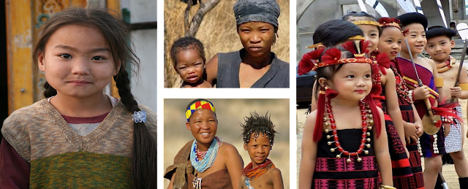
MONGOLOID
Mongoloid also entered the territories of Bangladesh from the East.
They spread mainly into the uplands and hilly areas.
They are closely related to Burmese and Thai.
They came here several thousand years ago.
Skin color: Yellow or yellowish brown.
Hair: Straight. The body and facial hair is scanty/nominal.
Face: Broad and flat with prominent cheek bones.

Slide 9
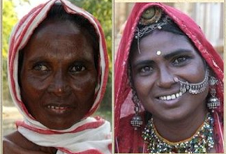
DRAVIDIAN
People who came 8000-10000 years ago from the Southern and western parts of South-Asia and they are known as Dravidians.
Physically diverse people speaking different languages, known as Dravidian family of languages.
Dravidian language speakers were mostly a Caucasoid people.
Generally darker than the different peoples to the East and West of South-Asia.
Developed Indus Valley Civilization.
Made their own city and became ruler.

Slide 10
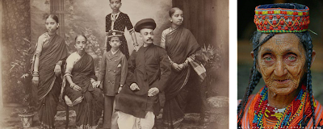
ARYANS
The latest arrivals were a people well known as the Aryans.
Spoke a language of the Indo-European family of languages.
Came with books: The Veda.
Came into South Asia around 1200 B.C. and flourished in the area now known as Haryana ‘Land of Aryans’.
Over the centuries they mixed with the Dravidians and settled in the relatively drier parts of the Ganges Valley.
This mixed population of Aryo-Dravidians moved into the Bengal Basin sometimes after 600 B.C.
They laid the foundations of urbanization in our country.

Slide 11

OTHERS
Later other immigrants-Arabs, Turks and Pathans also came to this land.
These people too added their physical stock to the melting pot, so that today we have in Bangladesh a great variety of physical features.

Slide 12
BENGAL DURING THE AGE OF MAURYAN EMPIRE (324 BC TO 186 AD)
There were no sources available to write any chronological history of ancient Bengal prior to the age of Gupta because people of that time were not used to writing history like those of today. We get a few sources of history from sporadic and separated comments in Indian and foreign literatures about Bengal of that time.
In fact, in 327 B.C. during the invasion of India by Greek hero Alexander, history took its original form. In the writings of Greek writers there was a powerful kingdom named 'Gongariddi' in Bengal. The nation 'Gongaridi' inhabited in the region between the two streams of the Ganges now known as the Bhagirathi and the Padma. The Greek writers referred to another nation called 'Prasioy' in addition to 'Gongaridi’. Their capital was Palibothra (Patliputra). It can be guessed depending on the descriptions of the Greek writers that these two nations took their arms against Alexander under the leadership of the same dynasty.

Slide 13
SUBJECT & MAUYAN EMPIRE
Just after two years of the departure of Alexander from India in 321 B.C. Maurya king Chandra Gupta Maurya established the lordship of Maurya Dynasty on a vast region of India (321 BC – 185 AD). During the reign of Emperor Ashoka (269 B.C.-232 B.C.) the Maurya rule was established in North Bengal. The region turned to a province of the Mauryans. Ancient Pundranagar was the capital of this province. Besides, north Bengal, Maurya rule was established in Karnasubarno (Murshidabad), Tamralipta (Hoogly) and Samatata (South-east Bengal).
List of Mauryan kings: Chandragupta (324-300 BC), Bindusara (300-273 BC), Ashoka (273-232 BC)
Subject | Mauryan Empire
The founder | Chandragupta Maurya
The best emperor | Ashoka
Previous | Nanda family
Next | Shunga clan

Slide 14
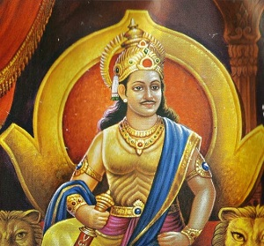
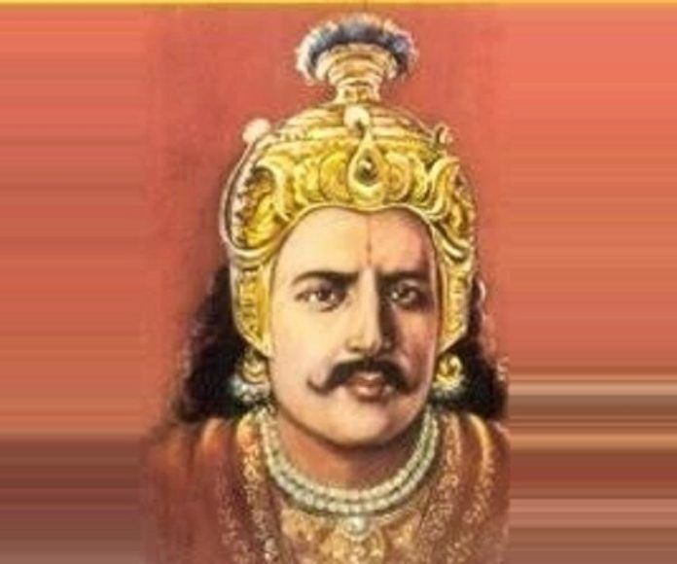
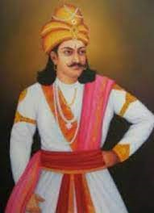
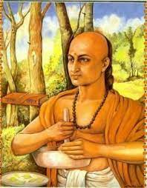
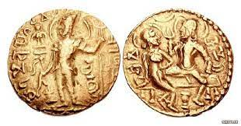
MAURYA EMPIREORS & COINS
Chandragupta Maurya
Bindusara
Empireor Ashoka
Chanakya or Kautilya
Maurya period coins

Slide 15
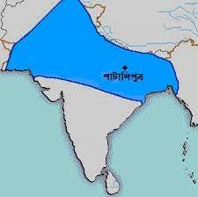
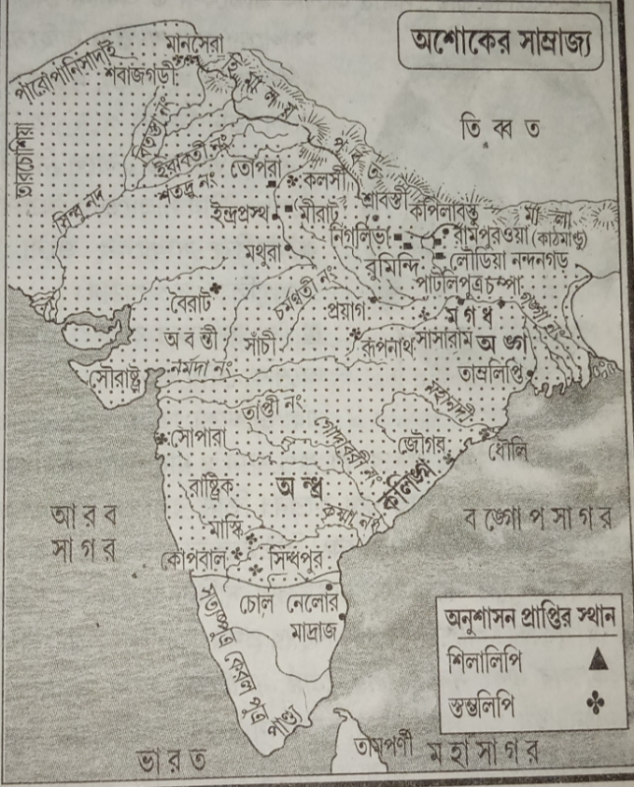
MAP OF MAURYA EMPIRE

Slide 16
MAURYAN ADMINISTRATION – STATE CONTROL
The Mauryan administration was a highly centralized administration.
Though it was a monarchy form of government which Kautilya insisted on, he stood against royal absolutism. He advocated on idea that, king should run the administration with assistance from council of ministers
A council of ministers called Mantriparishad were thus appointed for assisting the king.
The council consisted of Purohita, Mahamantri, Senapthi and Yuvaraja.
The important functionaries were known as the Tirthas.
Amatyas were the civil servants who were appointed to maintain day-to-day administration.
Rajukas were a class of officers appointed by Ashoka, who were responsible for rewarding and punishing the people.
In order to supervise the spread of dhamma, Dhamma Mahamatras were appointed.
The Capital city of the Mauryan empire, Pataliputra was administered by six committees each consisting of five members.
Two dozen departments of the state were maintained to control the social and economic activities near the capital city.
In the Mauryan administration, spies were maintained to track the foreign enemies and officers.

Slide 17
INFLUENCE OF MAURYAN EMPIRE
The Mauryan Empire was important for uniting the Indian subcontinent. It also was important for spreading Buddhism across its territory and for producing art and architecture that transitioned from the use of wood to stone as a primary material.
Hinduism, Jainism, and Buddhism were the three main religions in the Mauryan Empire. Emperor Ashoka is known for spreading Buddhism throughout the empire.
The Mauryan Empire was best known for uniting the Indian subcontinent for the first time as an empire. The empire reached its greatest territorial extent under Emperor Ashoka.
The main impact of religion in the Mauryan Empire was on its expansion. Emperor Ashoka expanded the empire to the tip of the Indian peninsula after a bloody war. Afterwards he converted to Buddhism and embraced peace which effectively stopped any further expansion of the empire. Buddhism was then spread across the territory through art and architecture.

Slide 18
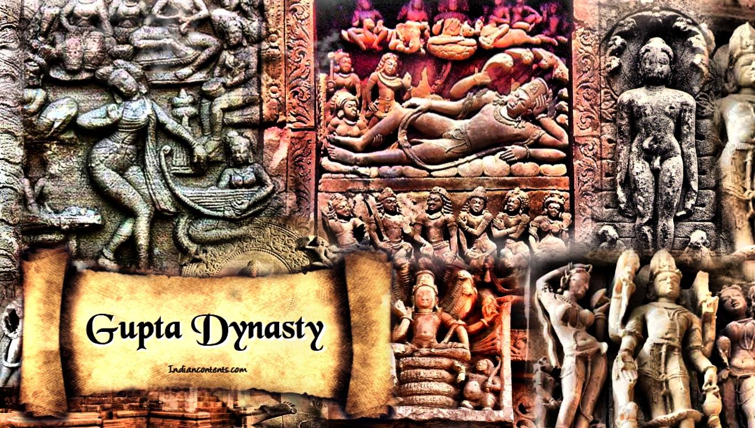
BENGAL DURING THE AGE OF GUPTA PERIOD APPROXIMATELY 319 TO 467AD
History of establishment in the Gupta Empire
After the fall of the Mauryan Empire, Indian politics began to experience isolation, regionalism and intrusion of foreign powers. The rise of the Gupta Empire was an active protest against him. The post-Kushana era saw the emergence of petty kingdoms in the political history of India. The Gupta empire arose based on the power vacuum in the Gangetic valley and the fertile lands of the Ganga-Yamuna valley.
Border: North: Himalayas South: Narmada East: Brahmaputra river West: Yamuna and Chambal rivers/Punjab Beyond this were the autonomous and allied states.

Slide 19
BENGAL DURING THE AGE OF GUPTA PERIOD APPROXIMATELY 319 TO 467AD
According to inscriptional evidence, the name of the founder of the Gupta dynasty was Srigupta. Srigupta ruled Varendra or its neighboring provinces. His capital was at Magadha. He only used the title 'Maharaj'. After the death of King Srigupta, his son Ghatotkacha became the king of this small kingdom. Neither father nor son was a great king; But Ghatokach's son Chandragupta I (320-340 AD) emerged as a mighty king after ascending the throne.
It was during the reign of Chandragupta I that the Gupta empire expanded and the development of the Guptas as an imperial power can be seen. Chandragupta I married 'Lichchhavi' princess. This matrimonial relationship multiplied the status of the Guptas. Before his death, Chandragupta I nominated his son Samudragupta as his successor.
Order of Kings: Maharaja Srigupta, Maharaja Ghatotkacha Gupta, Maharajadhiraja I Chandragupta, Samudragupta, Ramagupta, Chandragupta (II), Kumaragupta, Skandagupta, Purugupta Buddhagupta Narasimha Gupta, III Kumaragupta, Vishnugupta

Slide 20
BENGAL DURING THE AGE OF GUPTA PERIOD APPROXIMATELY 319 TO 467AD
India's Napoleon Samudragupta
After the fall of the Maurya Empire, Samudragupta established a sovereign power over the whole of India. Smith called him the 'Napoleon of India', noting the scale of his military campaigns and the extent of his state dominance. Samudragupta was born to Chandragupta I's concubine Kumaradevi.
Some time after 320 AD he declared himself the successor of his father and ascended the throne. He was a Brahmin. His empire extended to the Himalayas in the north, the Narmada in the south, the Yamuna and Chambal rivers in the west and the Brahmaputra river in the east. Samudragupta was not only a warrior or an expanding emperor, but he was also an engineer, a suave, a skilled ruler and a musician. He was the first to issue fully Indian coins. His artful gold coins are the glory of the Gupta period. Samudragupta was succeeded by his first son Ramagupta.
Chandragupta II or Vikramadityass
Ramagupta was an incompetent ruler. Then Chandragupta II or Vikramaditya ascended the throne in 380 AD and passed away in 413 AD. Vikramaditya was a warrior and an efficient ruler. He conquered Punjab, Mathura and later the Shaka kingdom of Malab and Gurjars. The Chinese traveler Fa-hien raved about his regime. His regime was liberal and philanthropic. After his death, his son Kumaragupta ascended the throne.

Slide 21
WHAT WAS THE GUPTA REGIME LIKE?
After the fall of the Maurya Empire, there was no unified state system in Bengal for a long time. The Gupta emperor Samudragupta Pushkaran defeated Chandravarma, the ruler of the kingdom, and occupied West and South Bengal. Later most of Bengal came under Gupta Empire. Gupta emperors ruled different regions of Bengal from 4th to 7th century AD. Many Gupta gold coins have been discovered from different archaeological sites of Bengal.
The Gupta regime was well regulated, orderly and well organized. The judicial system of this era was liberal and humane. The Gupta regime offers a wonderful glimpse of monarchy, democracy and alliance. For a long time the Gupta emperors protected India from foreign invasions. Because the regime was liberal, the people lived freely and comfortably. In this era, science, literature, and art had an extraordinary speed. Ancient Indian poets like Kalidasa, Bharvi, Shatraka, Visakhdatta etc. were cultural representatives of the Gupta period.
Amar Simha's poetic Sanskrit dictionary, Bhagavat's treatise on medicine, Varaha Mihir's Panchasiddhanta, Aryabhata's theory of instantaneous and annual motion introduce Gupta Manisha.
The Gupta period was extremely creative in art ie architecture, sculpture and painting. Mathura, Varanasi and Pataliputra were major centers of art during this period.

Slide 22
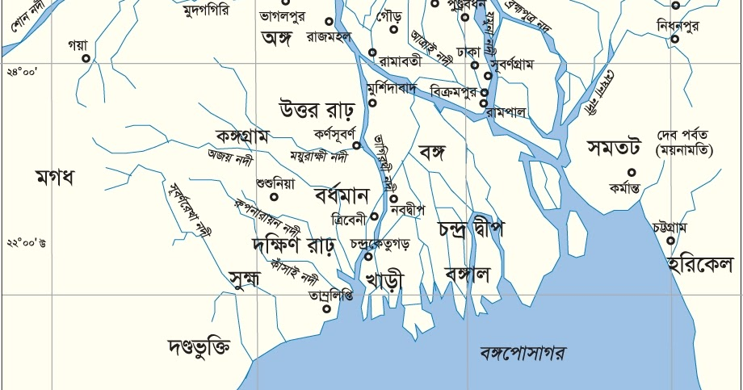
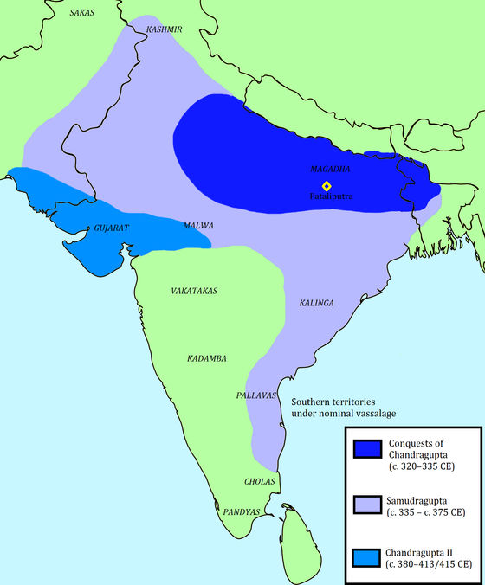
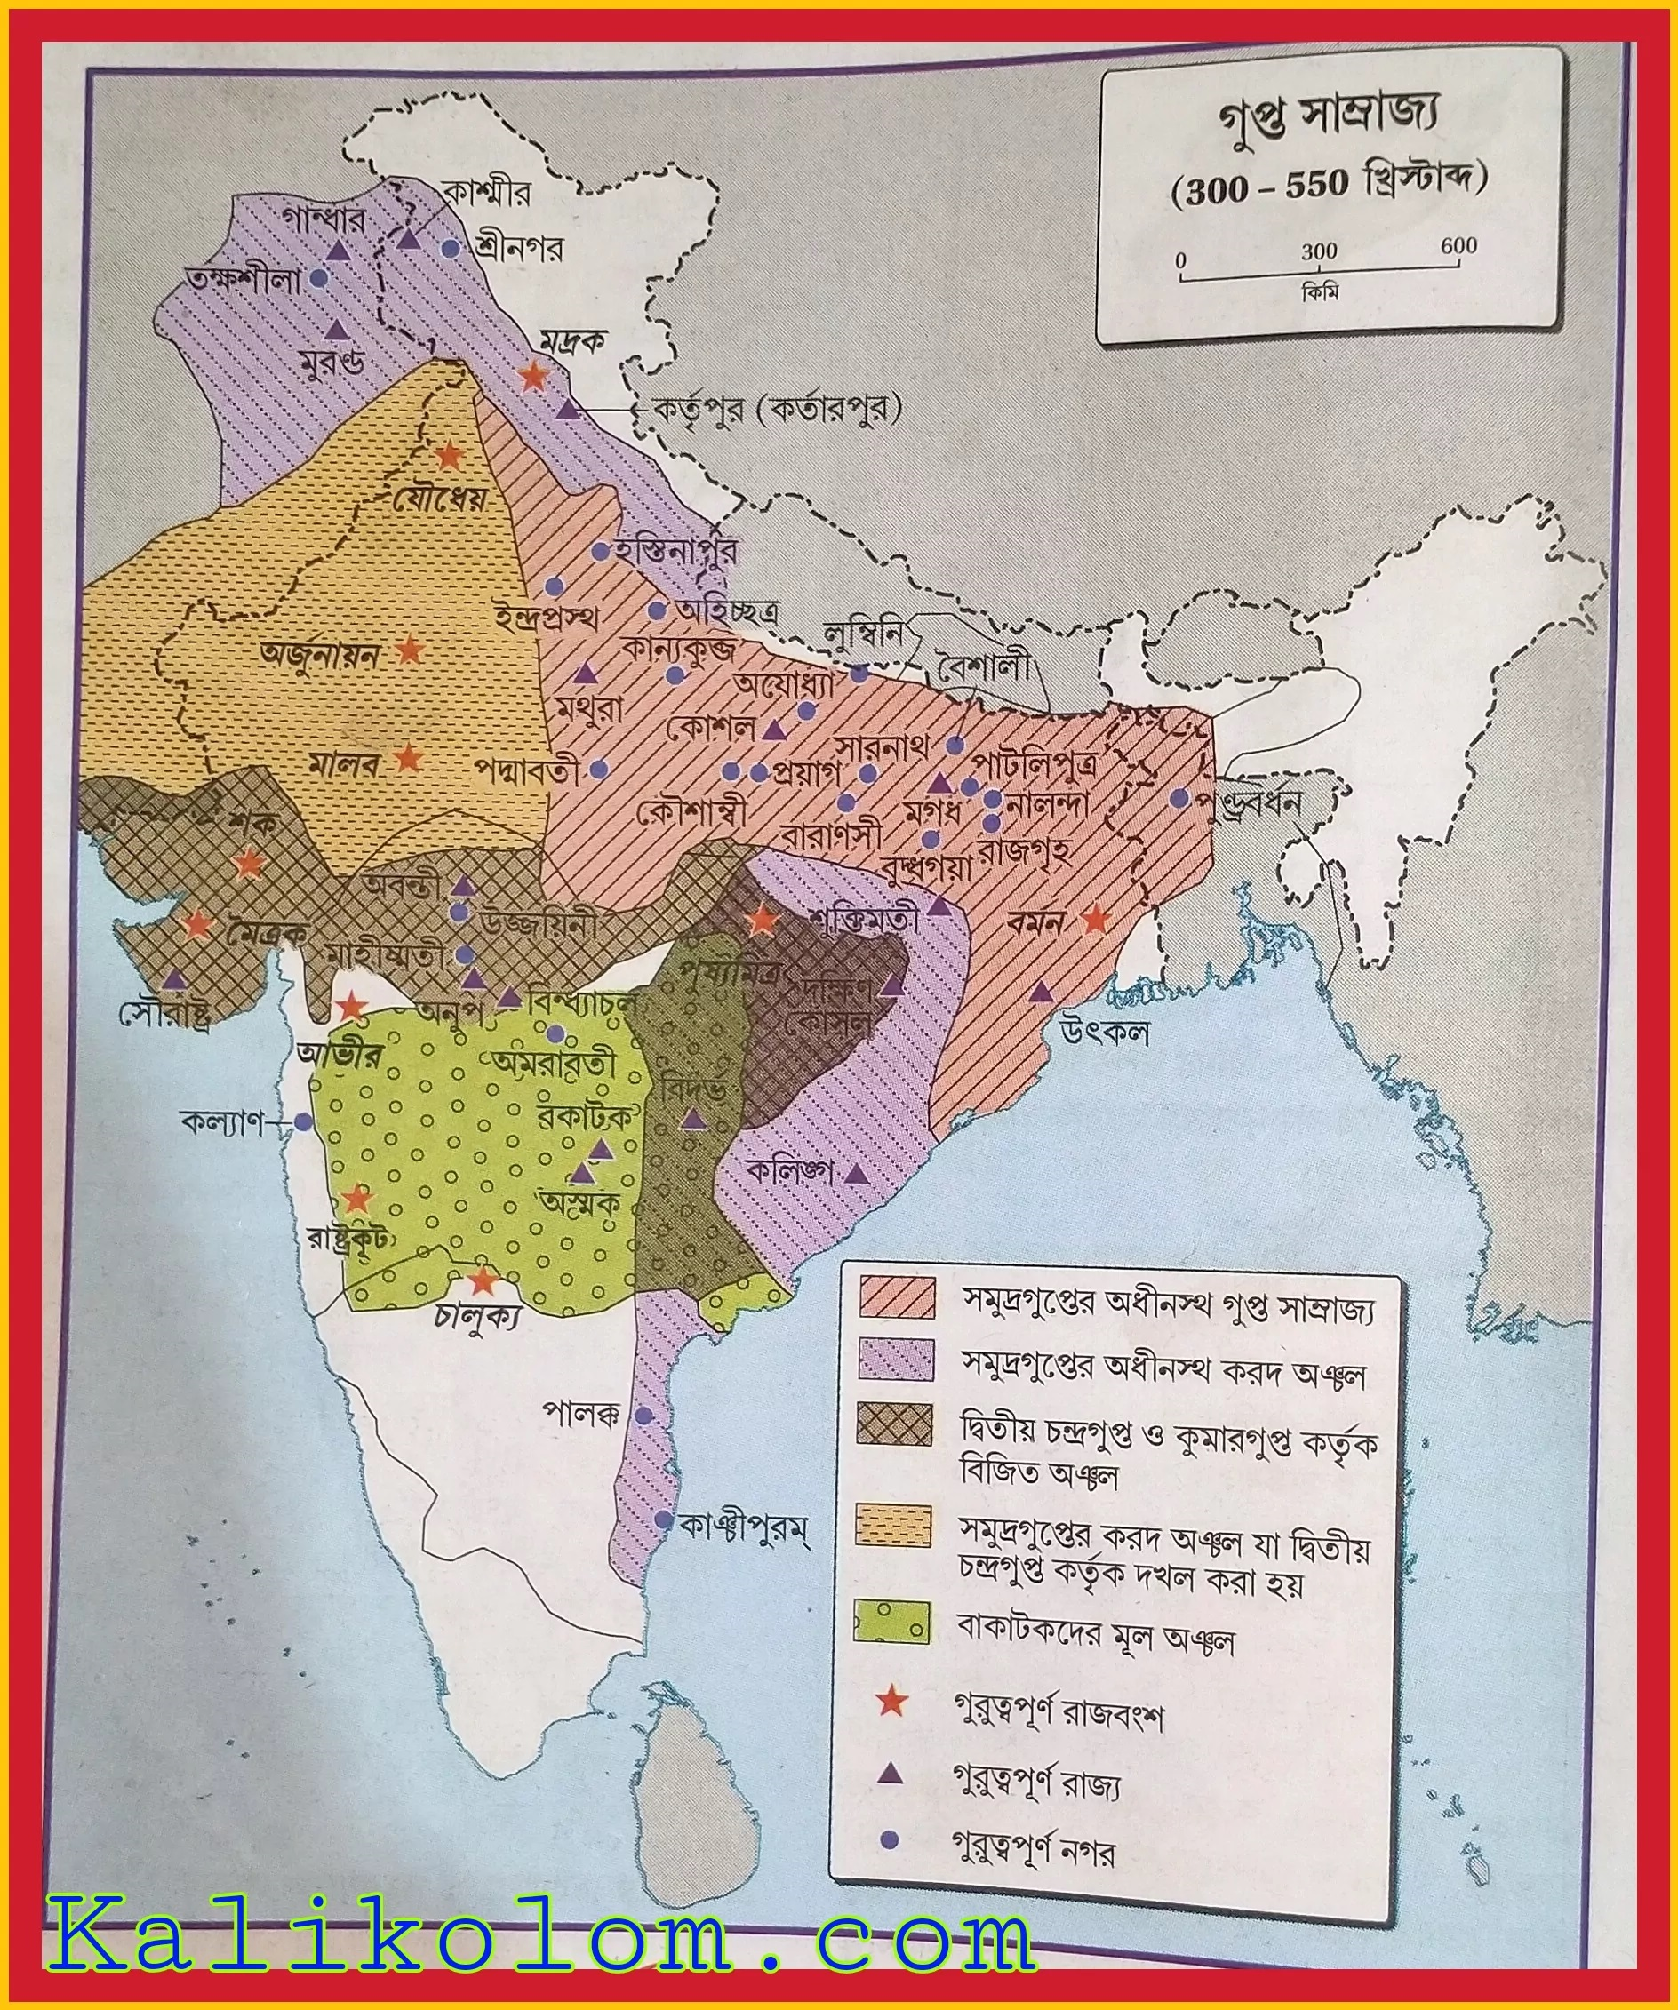
BENGAL DURING THE AGE OF GUPTA PERIOD APPROXIMATELY 319 TO 467AD
The Gupta Empire was an ancient Indian empire, existing from the mid-to-late 3rd century CE to 590 CE. At its most powerful time, which was from about 319 to 550 CE, it covered majority of the Indian area. Also, the period is remembered by its achievements in the arts, architecture, sciences, religion, and philosophy. Chandragupta I (320 – 335 CE) started a precipitous expansion of the Gupta Empire and soon established himself as the first sovereign ruler of the empire.

Slide 23
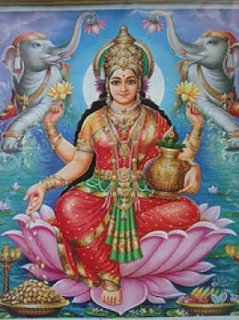
GUPTA DYNASTY RELIGION
The Gupta Dynasty had really strong Hinduism beliefs Both Buddhism and Hinduism were widely accepted. The characteristic features of Hinduism allowed them to survive considering the features of Buddhism led to its final decline. The rulers of the Gupta dynasty were all Hindu which is one reason the Buddhists were driven out.

Slide 24
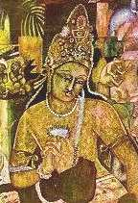
GUPTA EMPIRES ROLES OF WOMEN
In general women of the Gupta Empire were viewed as inferior to the men. However, they were still respected and were viewed as equals to the female gods. Women could be educated in the arts (primarily in music and poetry). They were not allowed to be educated in religious practices or read any sacred texts. Over the duration of the Gupta Empire, there was a downfall of the status of women primarily because of the rise of a new non-agricultural middle class. Women were not allowed to own property, and anything that they did own could be considered the property of her husband and father. At any given point in her life, a woman was always accountable to the will of a man. Women were married at 6 or 7 years old to ensure virginity and chastity. Since she lived with her husband, he could raise her to be the kind of wife he wanted. There were exceptions to this social system. Some women were even a part of government.

Slide 25
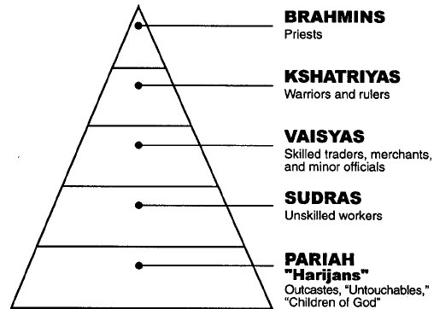
SOCIAL CLASSES OF GUPTA EMPIRE
The social structure of the Gupta Empire was highly influenced by religion. Hinduism divided the people of the Gupta Empire into five classes. The highest was composed of the priest and teachers, underneath that were the rulers and warriors, then the merchants and artisans, and ending with the unskilled workers.

Slide 26
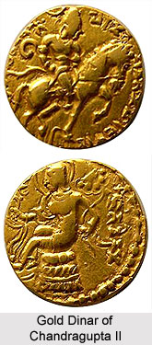
GUPTA EMPIRE: TRADE
They mainly traded with Rome, Thailand, Malaysia, Western Asia, China and Eastern Archipelago. Trading with many other countries caused their culture to spread and the belief of Buddhism to expand.
They traded goods such as Spices, precious, paddy, horses, copper, indigo, sugar cane, wheat, drugs, pearls, fruits, cotton, ivory, Muslin, calico, linen and varieties of clothing. Fruits and other food were exported in order to acquire silk and other goods. Trade of clothing to the other countries came from china and went through India to reach Africa/Rome.

Slide 27
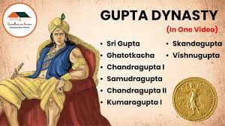
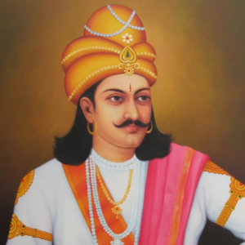
INFLUENCE OF GUPTA DYNASTY
Nalanda Vihar
Nalanda Mahavihara was a famous Buddhist educational and cultural center located in the ancient Indian state of Magadha (present-day Bihar). Nalanda Mahavihara was founded in 427 AD. It is believed that Gupta emperors were the builders of Nalanda Mahavihara and Sat first Kumaragupta took the first initiative in this regard. Around the seventh century, Nalanda became famous as a center of learning. At that time Nalanda had 10,000 students and 2,000 teachers. Many of them came from Korea, Japan, China, Tibet, Indonesia, Iran and Turkey. Chinese pilgrim Hiuen Tsang spent several years here to study.
The mystics of the Gupta period : Kalidasa, Fa-Hien, Aryabhata
The first ruler of the empire was Chandra Gupta I, and the founder of Gupta dynasty was Chandra Gupta 1 it is not to get confused with Chandragupta who founded the Mauryan dynasty in 321 bc).
Achievements of the Gupta Empire were around This period called the Golden Age of India and it was marked by extensive inventions and discoveries in science, technology, engineering, art, dialectic, literature, logic, mathematics, astronomy, religion, and philosophy that crystallized the elements of what is generally known as Hindu culture.

Slide 28
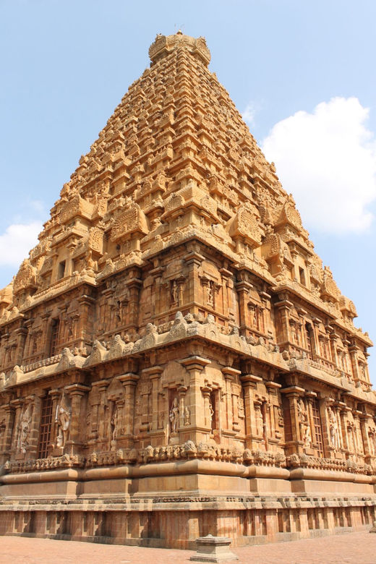
GOVERNMENT OF GUPTA DYNASTY
The Gupta emperors were divided into several divisions for the convenience of ruling Bengal. do Bhukti, Bhaya, Mool, Beethi and Village had these administrative divisions. The role of the Guptas in the introduction of administrative and land system is particularly significant in the history of Bengal. The economic condition of Bengal was good during the Gupta period. But in the 6th century, when the Gupta Empire was weakened by internal rebellions and repeated invasions by Injati, two independent states named Gaud and Banga emerged in Bengal.
Type of Government. Based in northern India, the Gupta Empire (320–600) was one of the largest political and military empires in world history. While the Gupta rulers named themselves the king of kings, they did not claim to be of divine origin and ruled with relative benevolence.

Slide 29
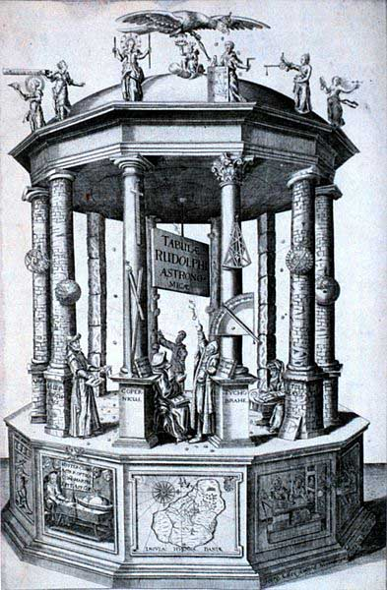
INVENTIONS AND TECHNOLOGY IN THE GUPTA EMPIRE
They made inventions and discoveries in science, technology, engineering, art, dialectic, literature, logic, mathematics, astronomy, religion, and philosophy. For Technology Guptas' scientists discovered that there were seven planets in the solar system. They also created the technology that was able to help them detect eclipses of the sun and moon. Arybhata was one of the most famous scientists in the Gupta Empire: He determined that Earth rotates on an axis and revolves around the sun.Jan 10, 2014

Slide 30
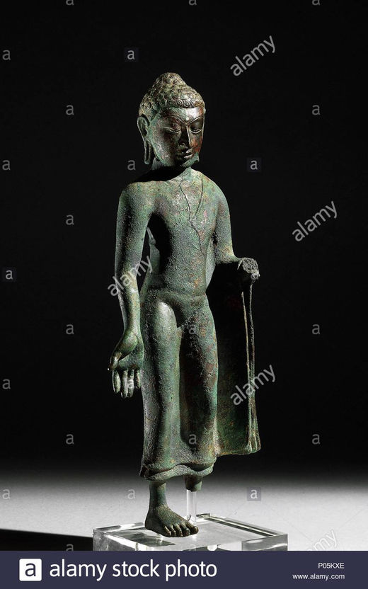
END OF CIVILIZATION OF GUPTA EMPIRE
Caused the fall of the Gupta Empire
The great empire built around Magadha by the untiring efforts and military genius of Samudragupta and Chandragupta II began to decline from the end of the fifth century AD and ended completely in the middle of the sixth century.
Skandagupta is said to be the last major emperor of the Gupta Empire. He died in 467 AD. The weakness and incompetence of his successors in governance was one of the main reasons for the downfall of the Gupta Empire.
Samudragupta used to give back their kingdoms to defeated kings in return for regular tribute and obedience. Later, due to the weakness of the Gupta kings, when these provincial rulers rebelled, they could not be suppressed.
An important contemporary power of the Guptas were the Batakas. They help the Pushyamitra or Hun invaders due to a rift in their relationship. The Gupta Empire fell at the hands of these Huns
The Huna People, invaded Gupta territory and caused critical damage to the empire. The Gupta Empire ended in 550 CE, when it disintegrated into regional kingdoms after a series of weak rulers and invasions from the east, west, and north. The Gupta Empire flourished, in military and territorial conquests as well as cultural and scholastic advancements, during the reign of Emperor Chandragupta II. Yet the succeeding rulers, beginning with Kumaragupta I and then Skandagupta, oversaw the eventual end of the Gupta Empire through military defeats, devalued money and withering leadership.

Slide 31
THE INDEPENDENT KINGDOM OF BANGA
An independent kingdom emerged in the Banga Janapada with the advantage of the weaknesses of the Gupta's Empire. It was known from 'Copper inscription' on copper that three kings named Gophandra, Dharmaditya and Samachardeva ruled independent Bengal. All of them assumed the title 'Moharajadhiraj'. Their regime was between 525A.D. -600 A.D. It cannot be said when and how the independent and powerful Bongo kingdom collapsed. It is a notion that Kirtivarman was the last king of independent Banga. The rise of some feudal kings is also held responsible for the fall of independent Bengal because before the seventh century independent and feudal kings belonging to Bhadra, Kharga, Rahr dynasty rose in the kingdom Samatata of south Bengal.
After the fall of the Gupta dynasty in the sixth century the kings known as the 'later Gupta dynasty' with the title 'Gupta' extended their domination in North Bengal, northern side of West Bengal and Magadha. In the middle of the sixth century Gaur became known as a Janapada in this very region. Taking the complete advantage of this condition, a some feudal king named Shashanksa grabbed the power of Gaur region and established Gaur kingdom at the beginning of the seventh century.

Slide 32
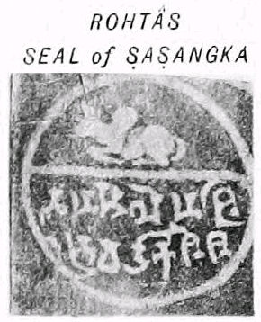
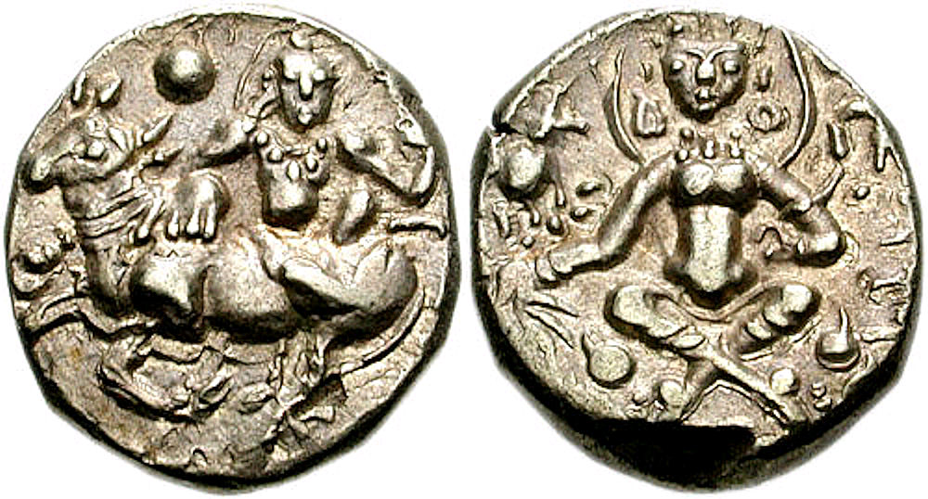
GAUR UNDER THE LEADERSHIP OF SHASHANK CREDIT TO SHASHANK
The capital is Karnasubarna, The common language is Bengali, Religion is Hindu, The government is a monarchy, the king, • 606 – 638 Shashank, • 638 – 640 Manab, The historical period is Harshabda • Establishment 606 • Extinct 640
Gaur Emperor Reigned 606 - 638 AD, Predecessor Mahasengupta, Successor Manab (king)
Gaur Emperor coin

Slide 33
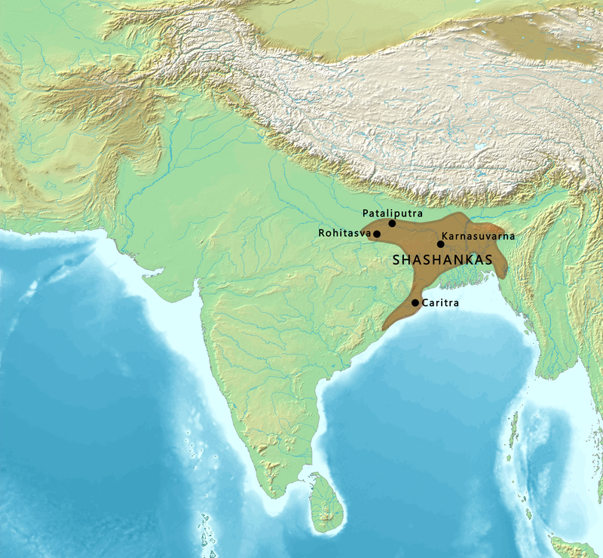
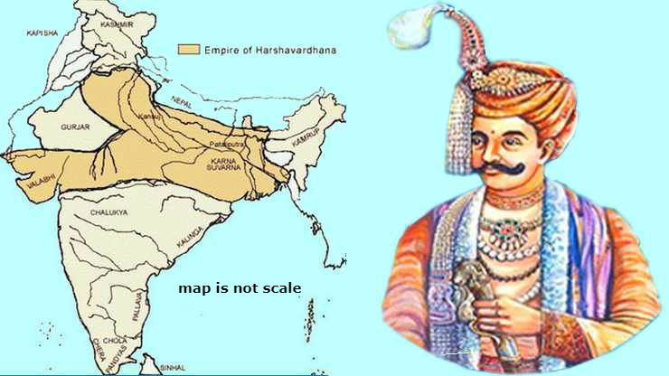
GEOGRAPHICAL EXTENT OF THE GAUR KINGDOM IN PALE-GREEN ON A MAP OF THE MAJOR KINGDOMS OF SOUTH ASIA AT THE TIME OF SHASHANKA'S DEATH APPROXIMATELY, 625 AD.

Slide 34
THE LEADERSHIP OF SHASHANK
Shashanka was the first important king of ancient Bengal, who occupied a prominent place in Bengal history. It was generally believed that Shashanka ruled approximately between 600 AD and 625 AD, and two dated inscriptions, issued in his 8th and 10th ruling years from Midnapore, and another undated inscription from Kharagpur have been discovered. The copper plate from Shashanka's subordinate king of Madhav-Varma, Harshavardhana's and Madhuvan copper plates contain information about Shashanka.
King Shashanka also issued gold and silver coins. Between the decline of Guptas and the rise of Shashanka, a number of independent rulers flourished in Bengal in the intervening period and their existence is known from a few inscriptions and gold coins. In the inscriptions and literary accounts also Shashanka is described as the ruler of Gaura.

Slide 35
EXTENDING POLITICAL INFLUENCE; ART & ARCHITECTURE OF SHASHANKA DYNASTY
Extending political influence: The ruler Shashanka first established himself in Gaura, the north-western region of Bengal, and made Kornosubora in Murshidabad his capital. Then he gradually extended his rule in Bihar. The contribution of Shashanka in the history of Bengal was that he defended the independence of the Gaura empire against a very powerful northern Indians powers. For a king of Bengal, it was a great show of strength to have ventured into northern Indian politics. So he can be seen as the first important king of Bengal, who for the first time brought him into competition with other states for control of northern India. In this sense, he was the forerunner of the aggressive northern Indian policy of the later Pala rulers such a Dharmapala and Devpala.
Art & Architecture of Shashanka Dynasty: The archaeological site of Kolkata found a number of structures include the base of several square and circular stupas, remains of square rooms (probably classrooms or rooms where the students put up), remnants of two walls (possibly the boundary of the capital). Sarasanka build/excavated a massive dighi (lake) measuring over 140 acres which is nearly equal to the total area of 80 football fields. He developed metropolitan city ideas.
Shashanka, is credited with creating the Bengali calendar. The term Bangabda (Bangla year) is found too in two Shiva temples many centuries older than Akbar era, suggesting that a Bengali calendar existed long before Akbar's time.

Slide 36
MATSYANYAYAM
Matsyanyayam the condition of Bengal in the century following the death of Shashanka and before the rise of the Pal dynasty (750-850 AD) has been described as Matsyanyayam.
The Sanskrit term Matsyanyayam, used in ancient texts, bears special significance. The Kautilya Arthaxastra defines the term as follows: When the law of punishment is kept in absence, it gives rise to such disorder as is implied in the proverb of fishes, i.e., the larger fish swallows a smaller one, for in the absence of a magistrate, the strong will swallow the weak.
Matsyanayam refers to a condition of anarchy and disorder like when the big fishes catch and swallow the small fishes in a pond. The powerful kings of Bengal took complete control over small regions in such a way. This period of anarchy lasted for one hundred years. In the middle of the eight century this anarchy and disorder came to an end with the rise of the Pala reign.

Slide 37
MATSYANYAYAM
Tibetan historian LAMA mentioned that all of Bengal was pervaded by an unprecedented anarchy in the century before the rise of the Pala dynasty. Government was fragmented, with no king having real control over GAURA, VANGA and SAMATATA. Brahmanas, merchants and townsmen all were kings in their own homes. The sufferings and strife of the common people were intolerable.
From the above it appears clear that in the century following the reign of Shashanka Bengal saw very little of stable government. The country was torn into many small kingdoms and warfare among them caused the instability. In the absence of a strong force capable and internecine of enforcing law and order, a situation prevailed that has been termed as Matsyanyayam. Physical strength was the only strength. In order to put an end to this state of affair, Gopal emerged as the king of Bengal and founded the rule of the Pala Dynasty.

Slide 38
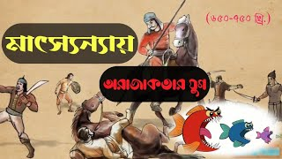
MATSYANYAYAM

Slide 39


